Slide 1

STEM Challenge
With 5th and 6th class
PowerPoint by Tom , Daniel W and Kelan in 6th class

Slide 2
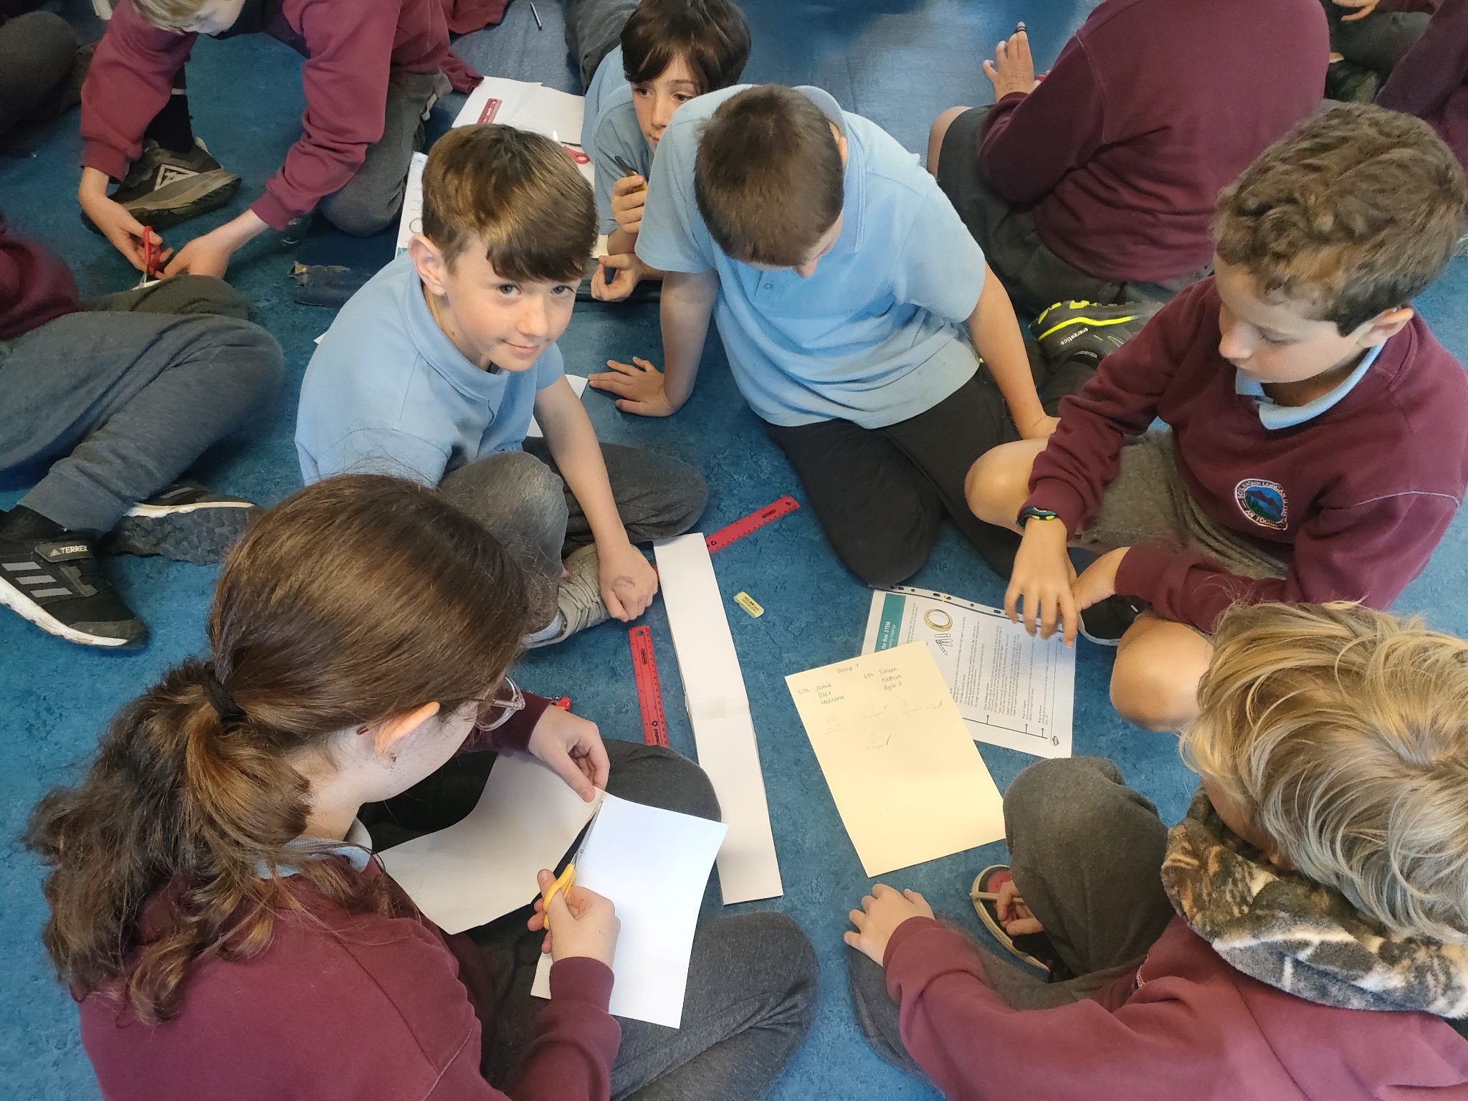

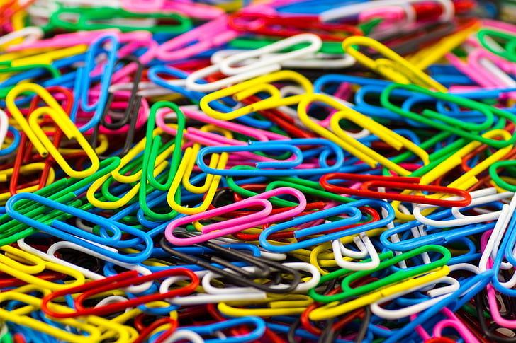
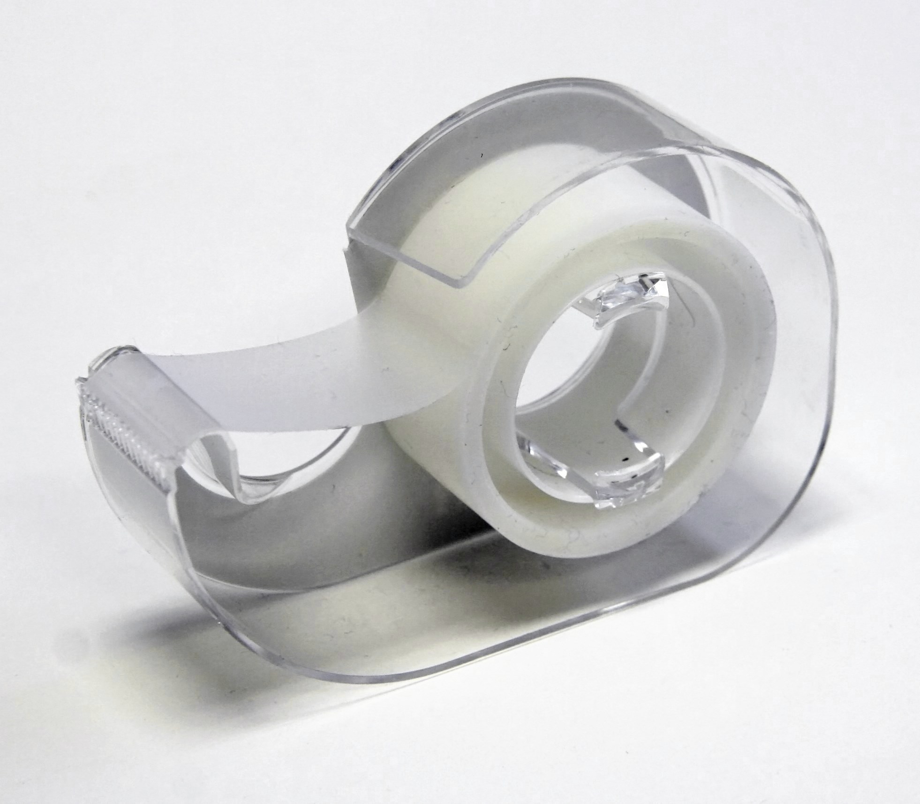
Building Bridges
We could only use A4 paper, selotape and paperclips to build them
The bridges we built had to be up off the floor and had to be minimum 50cm in length

Slide 3
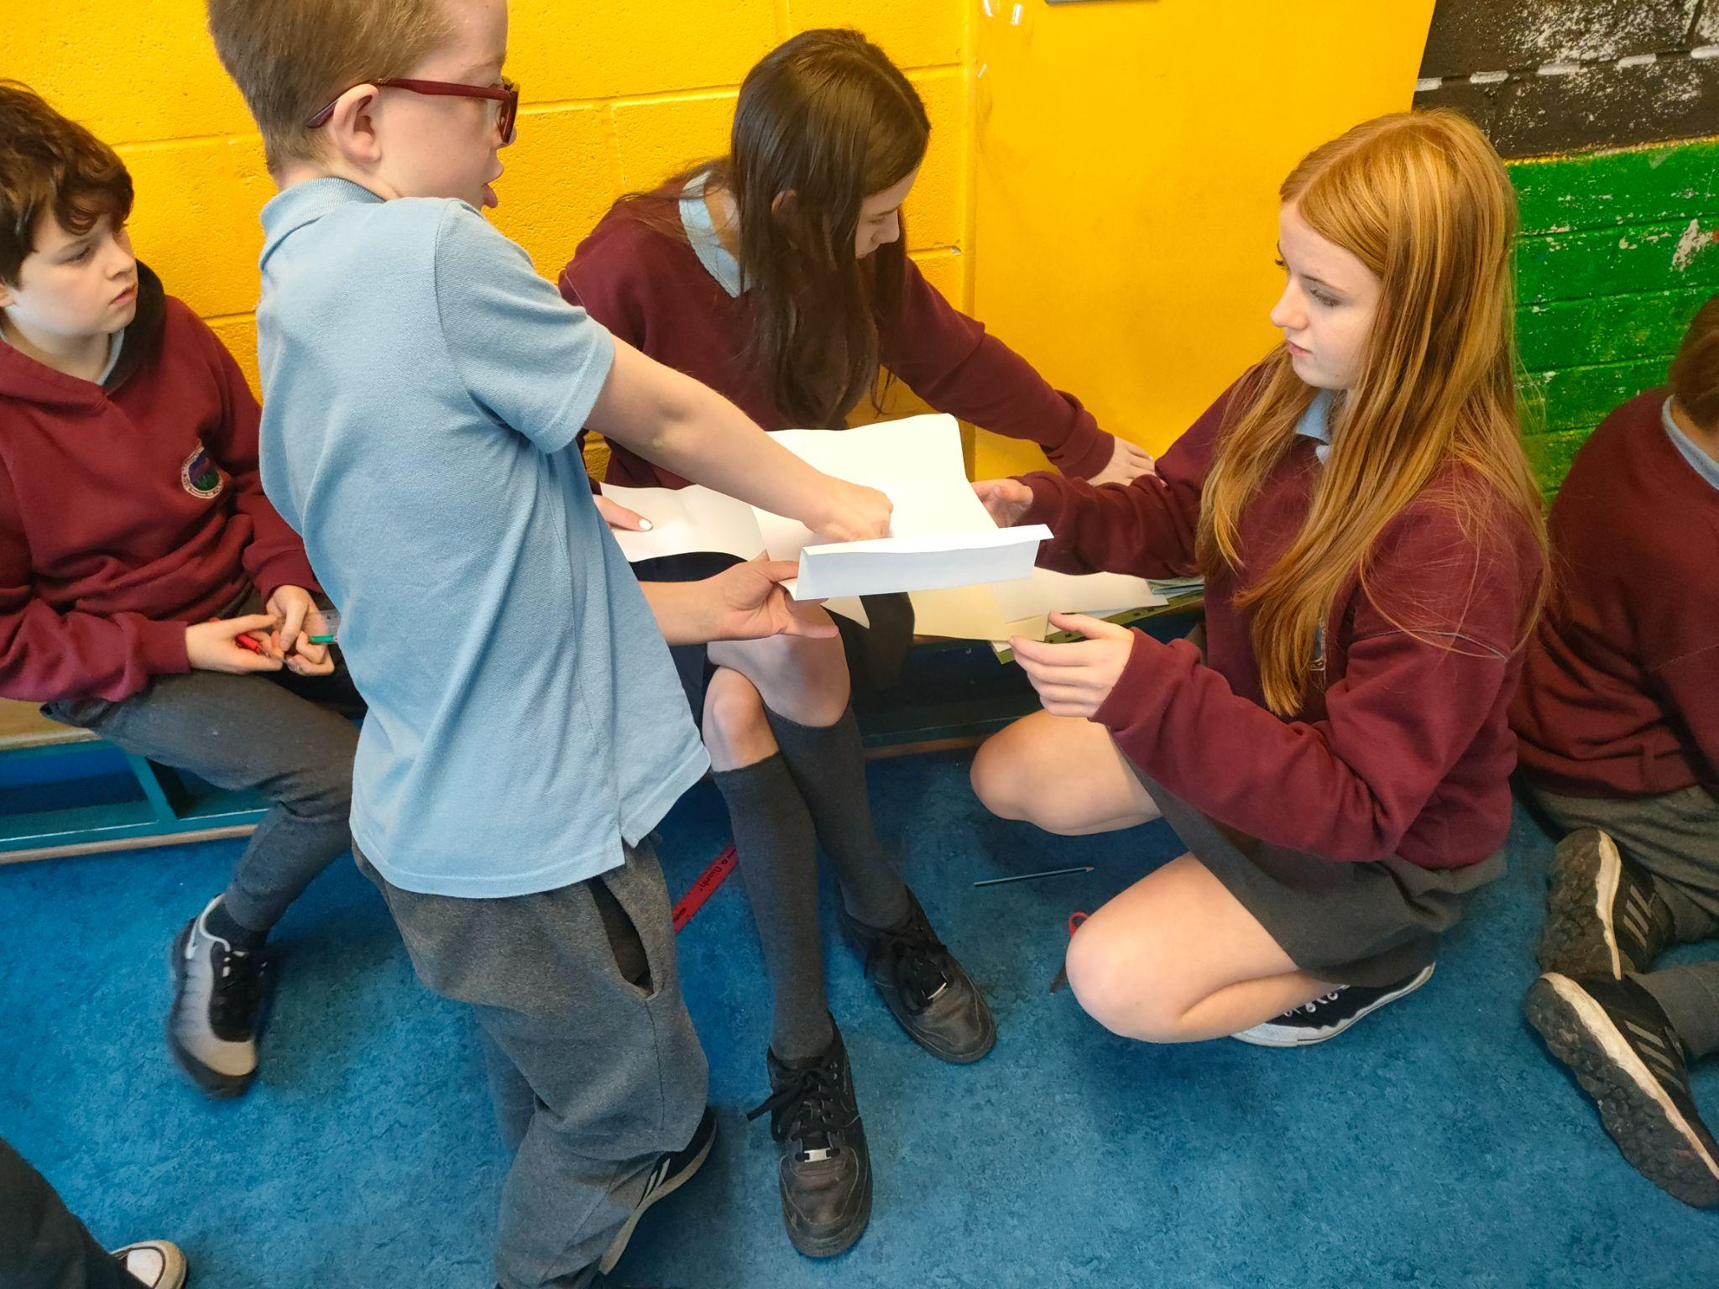

Teams
The teams were mixed with 5th and 6th class 3 people from each class on a team

Slide 4

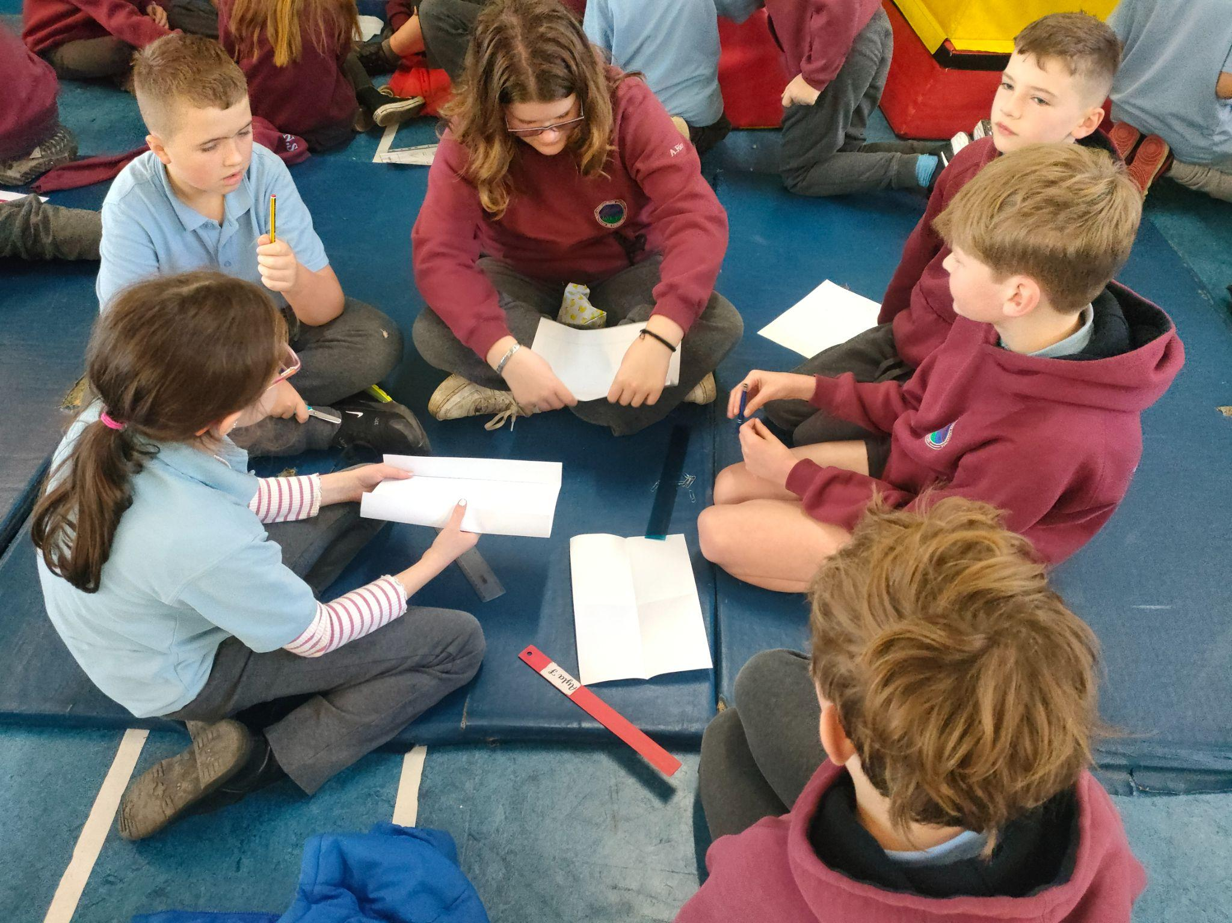


Points to Spend
All teams have 50 points to spend on: sticky tape (2 points for 10cm)
paper (6 points) paperclips (1 point )

Slide 5
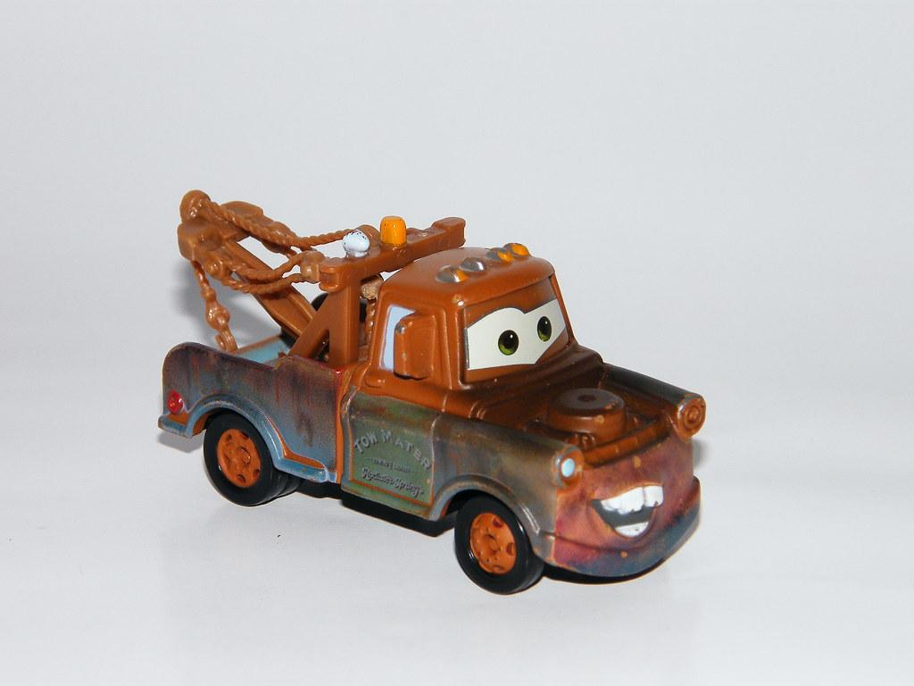
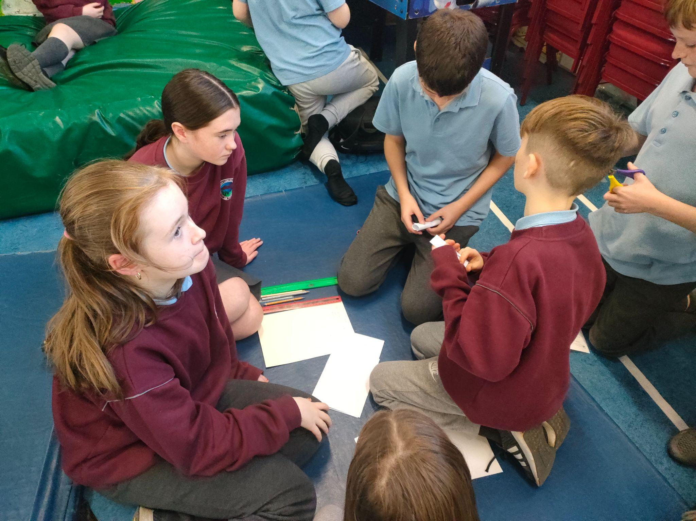
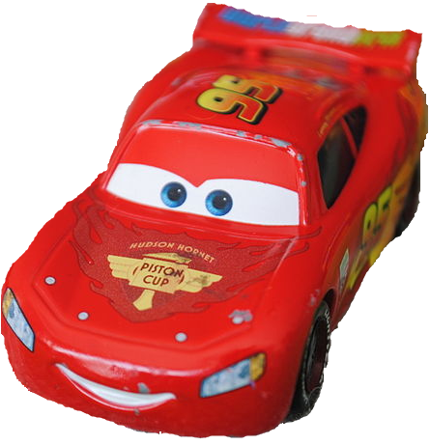
The Brief
The bridge had to hold a toy car which had to drive along the bridge without falling or breaking the bridge

Slide 6
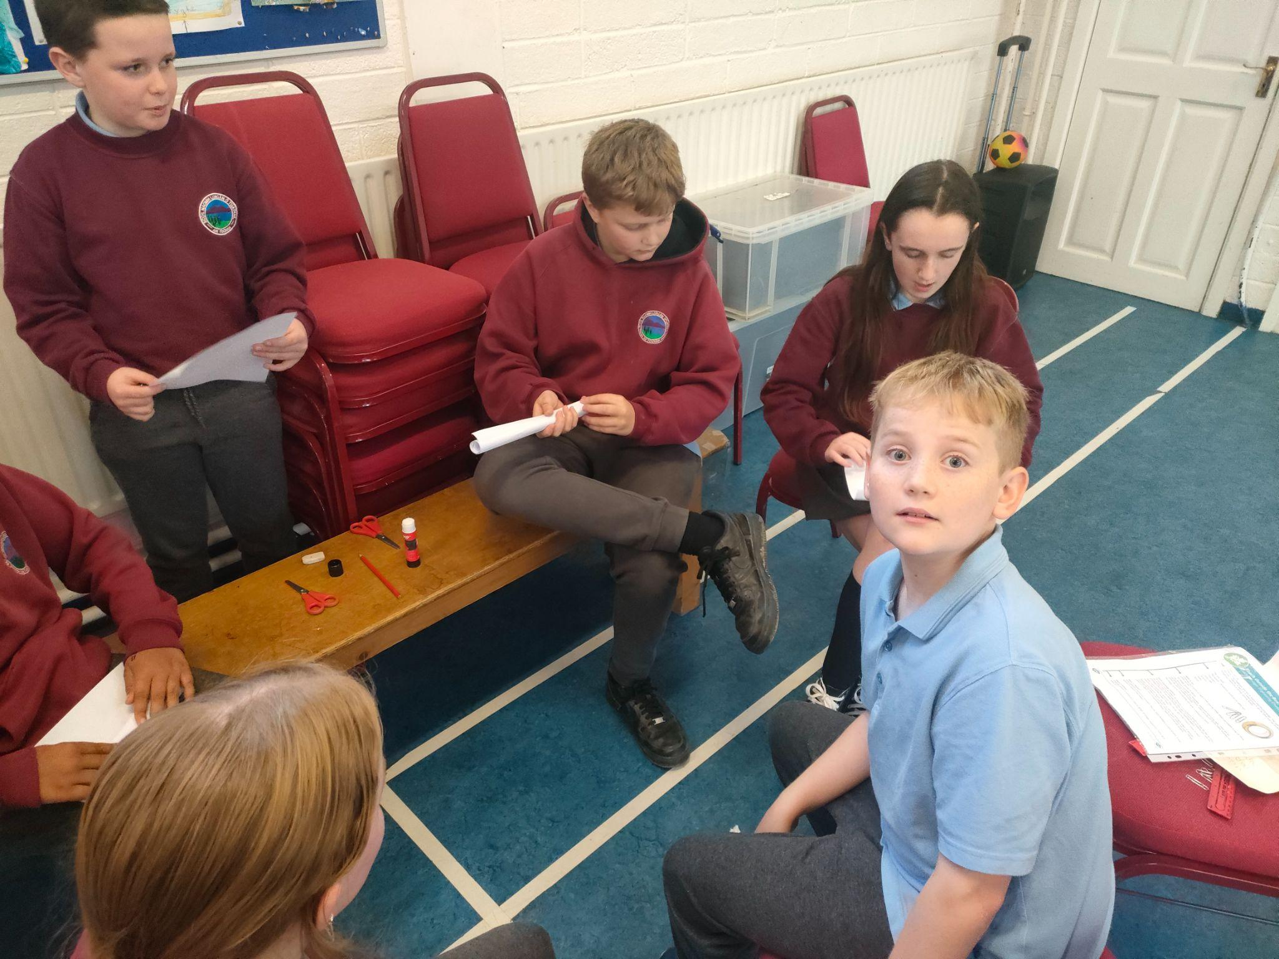


Time Limits and Specifics
We had thirty minutes to make the bridge which had to be a minimum 50cm

Slide 7
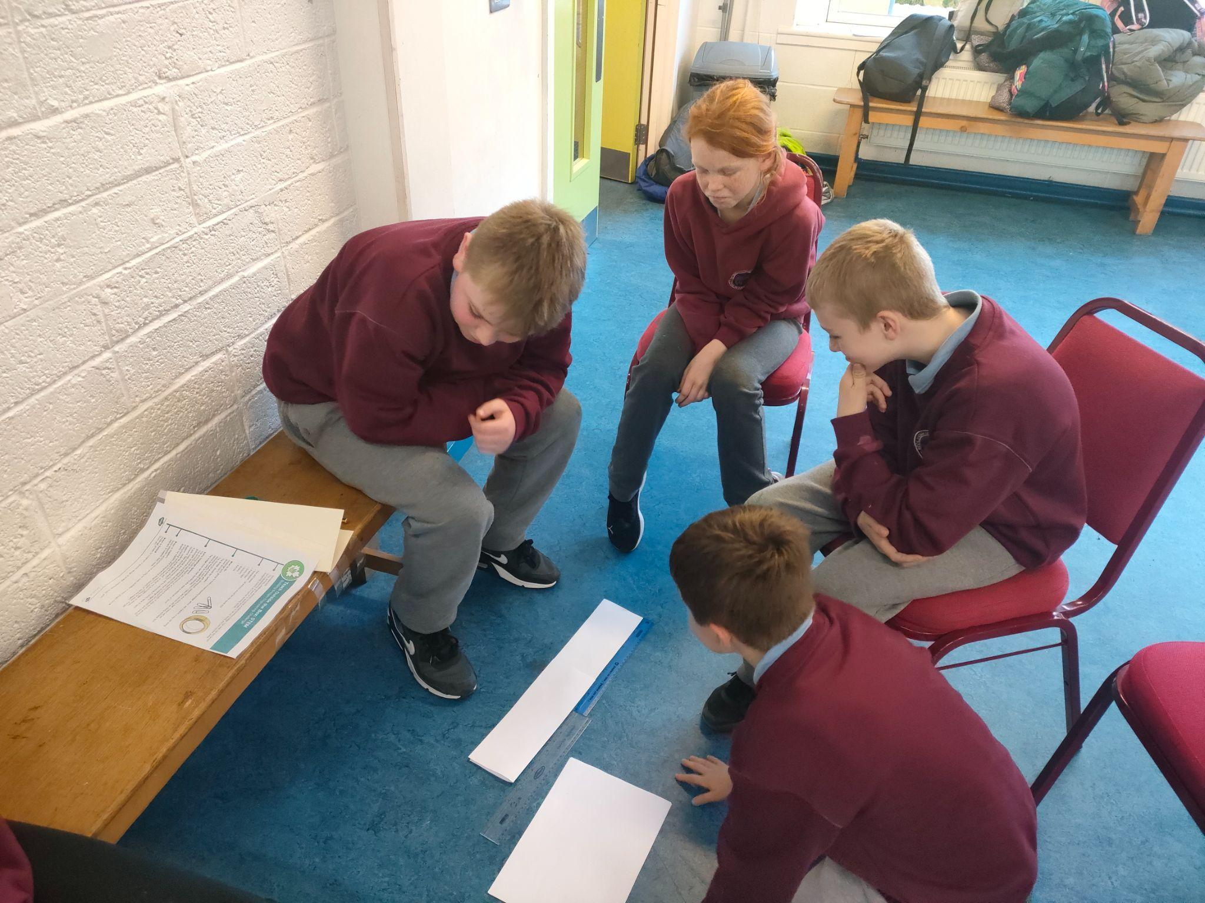

Loads of teams used different tactics to make a bridge

Slide 8
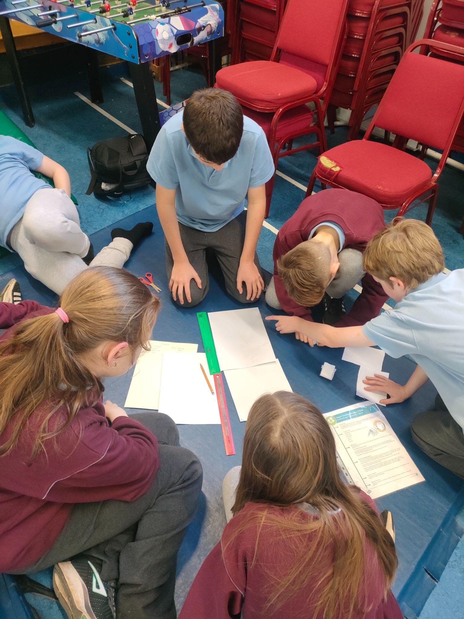
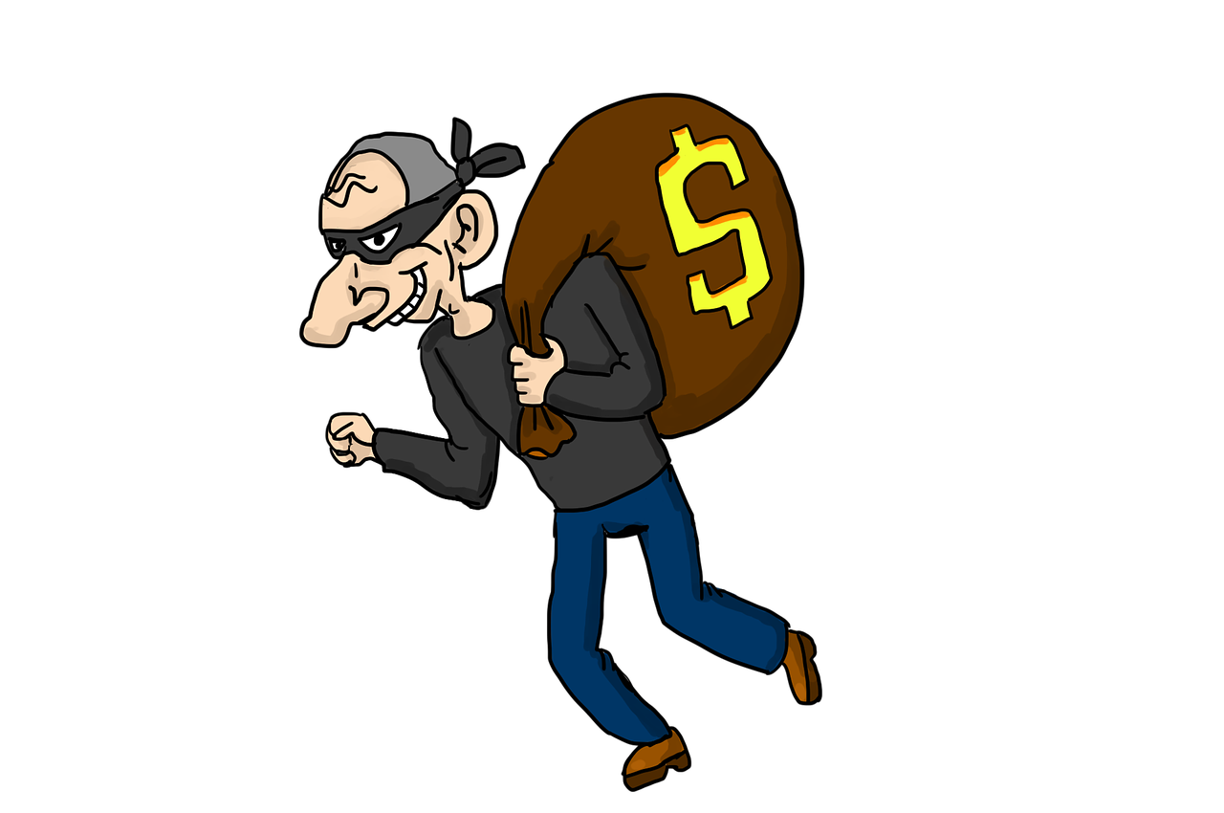

It got competitive and people tried to steal ideas and materials from other teams

Slide 9

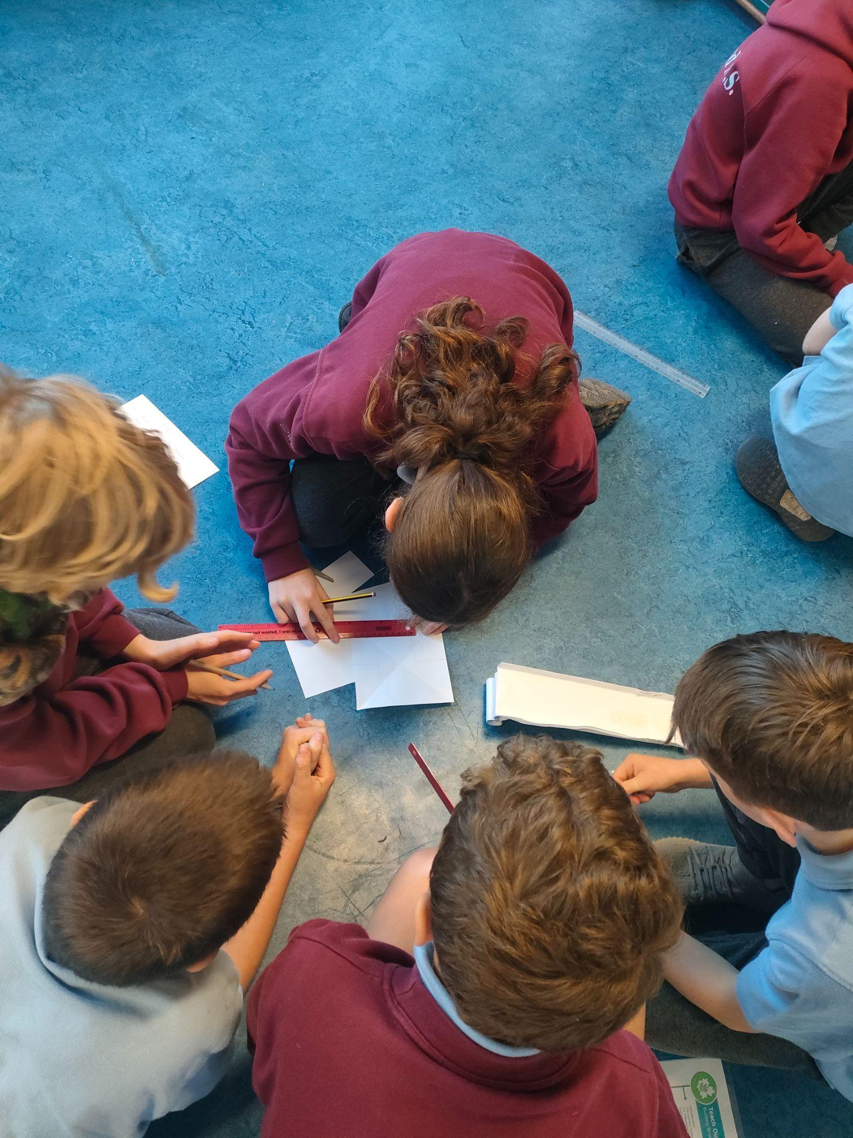


People named their bridges too!

Slide 10

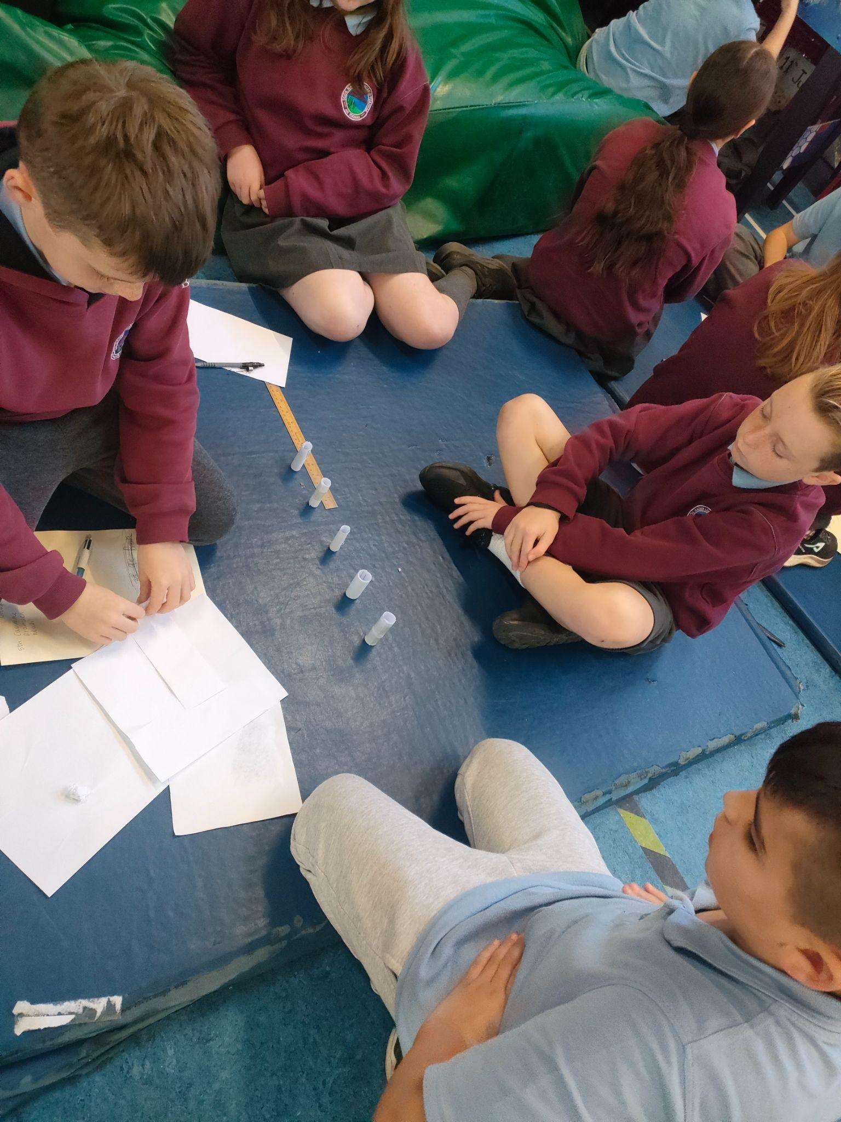

Mr Flood and Ms O’Byrne were very impressed with the collaboration and teamwork during the experiment.

Slide 11
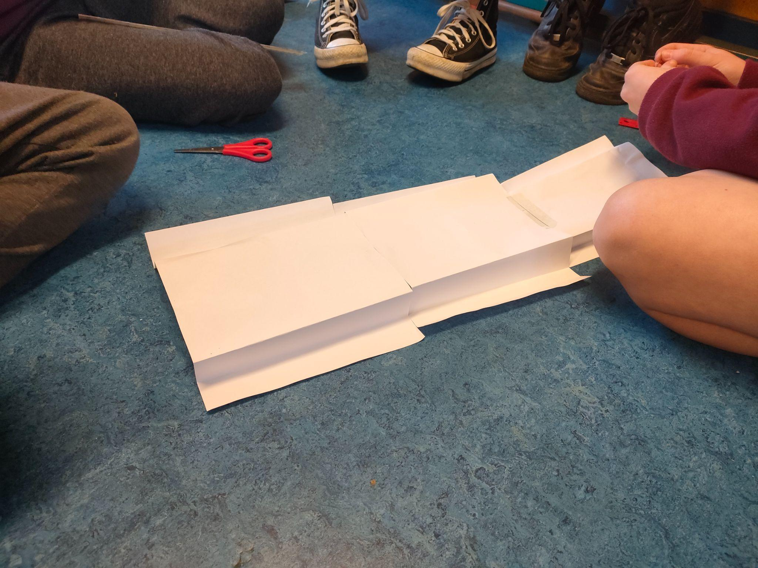
Teams came up with different ways to keep the bridge off the ground, including folding, rolling and bending the paper

Slide 12

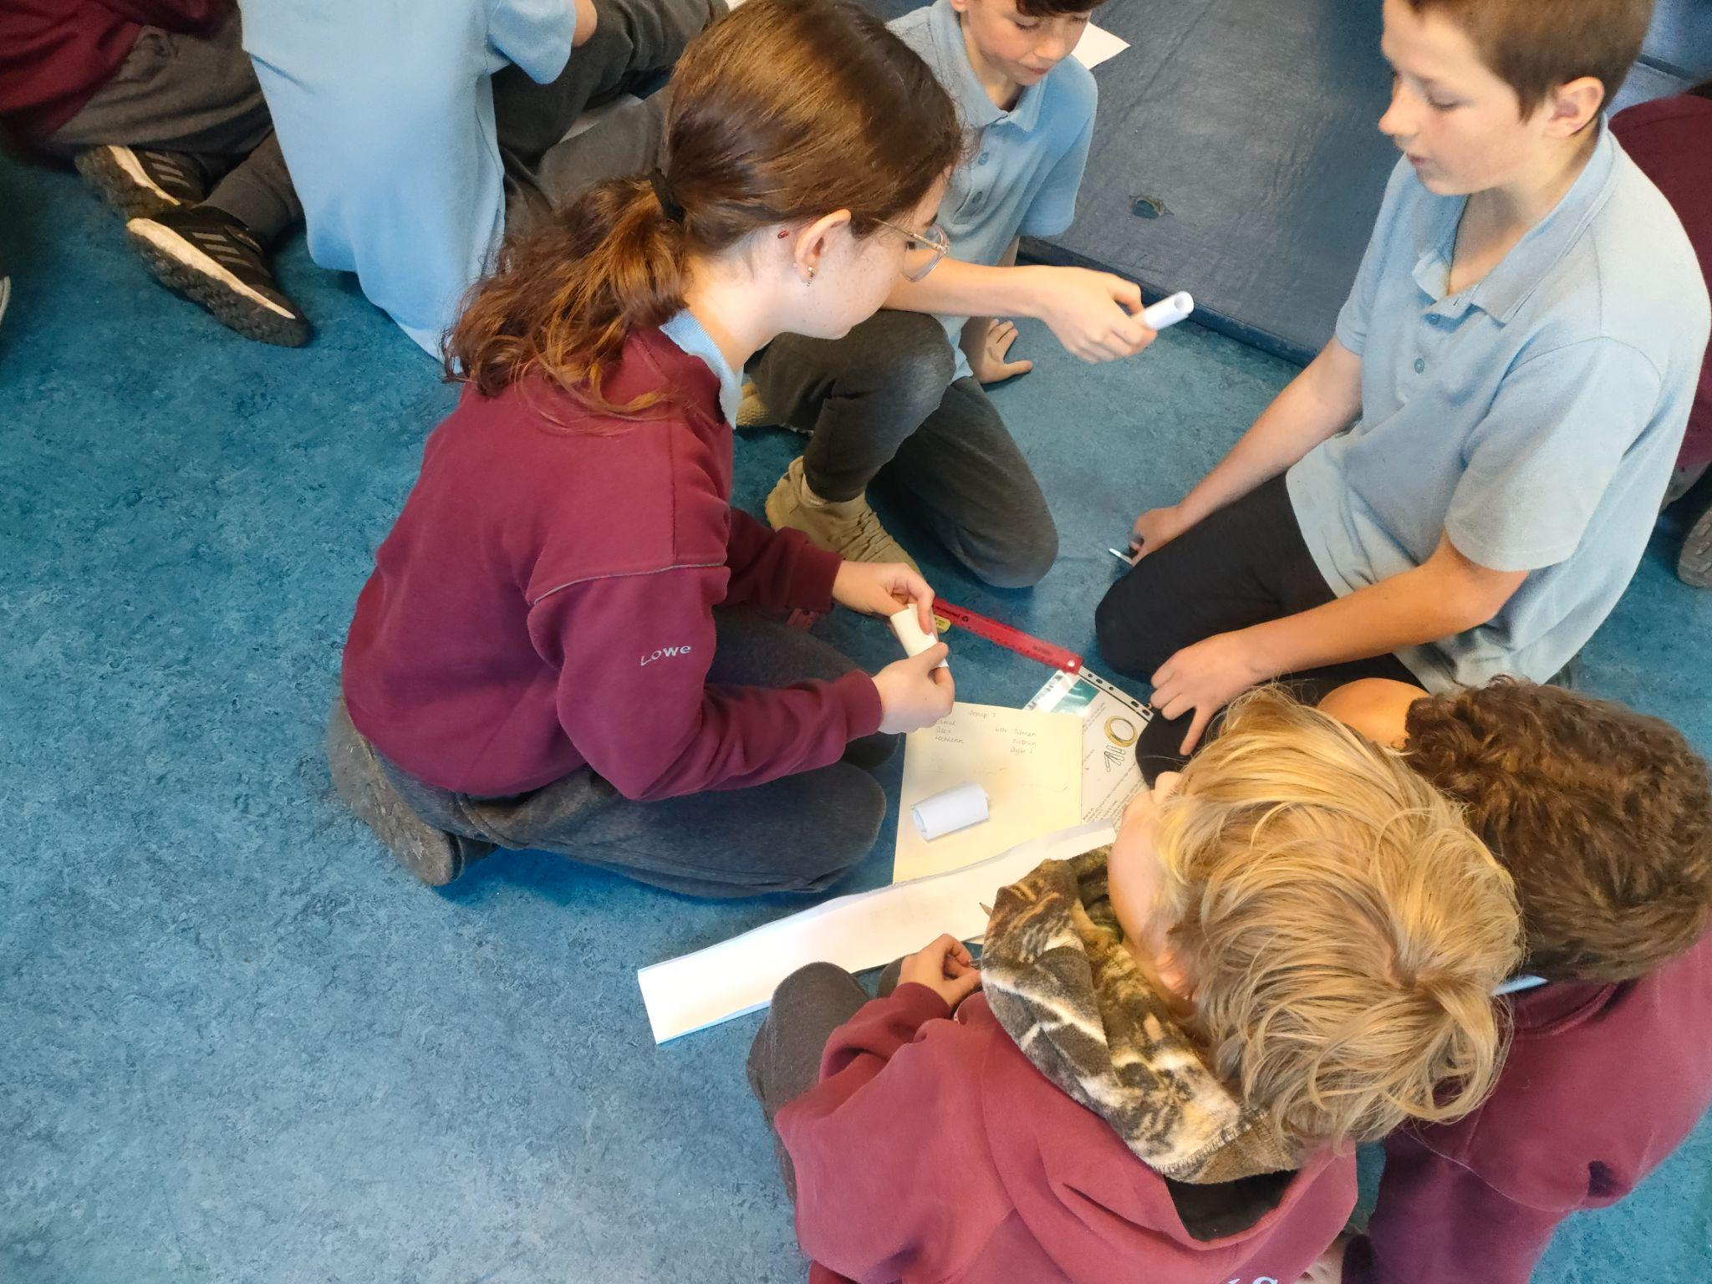
All the ideas were brilliant and the groups got creative and thought outside the box! Well done to all involved!

